Slide 1
Cyber Shooter
SGD pitch
Spring 2013

Slide 2
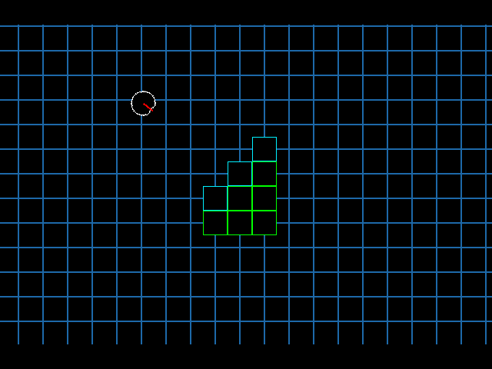
Concept

Slide 3
Team-based
Emphasis on multiplayer
Installations (turrets, mines, barricades, etc.)
Pickups
Halo-style arcade play
Easy to learn
No classes, no exp to gain
Gameplay

Slide 4
Game engine in Java
Model-View-Controller architecture
Messaging system (for hooks, etc.)
Tile engine
Collision detection and response
Rudimentary physics
Resource database
Java2D for graphics
Github for code hosting
Technical Details

Slide 5
Game mechanics
Weapons
Installations
Powerups
Other game modes (CTF, single-player)
Networking for multiplayer
Map and resource editors
Particle engine
Needed Work

Slide 6
Engine programmer
Mechanics programmer
Network programmer
Toolchain programmer
Design lead
Artist/Musician/Resource manager
*Needed members are in white
Team Organization

Slide 7
?
Questions?

